Slide 1






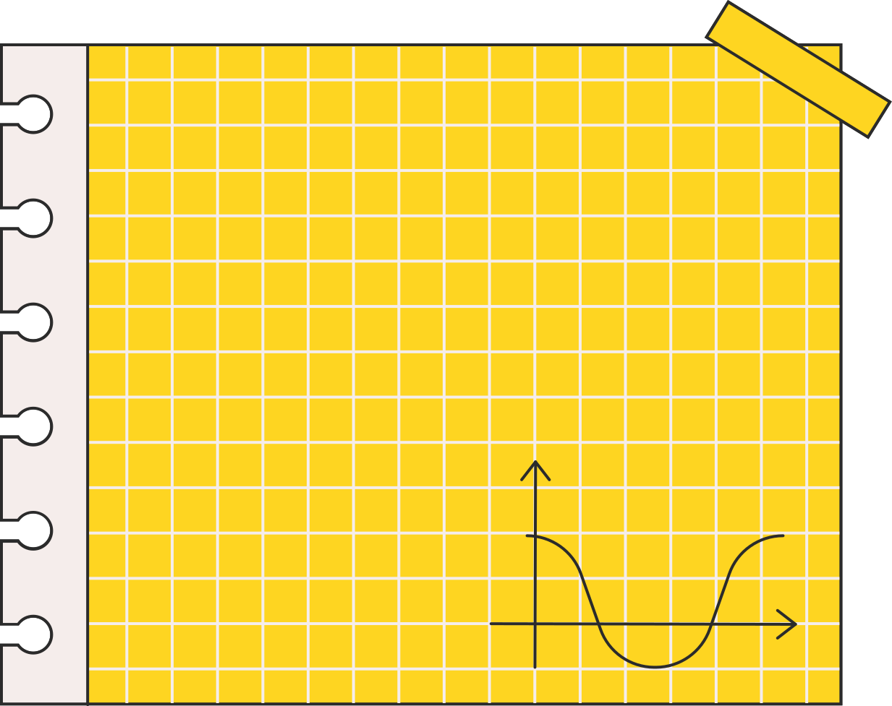



PERSONALITY PREDICTION SYSTEM USING CV ANALYSIS

Slide 2






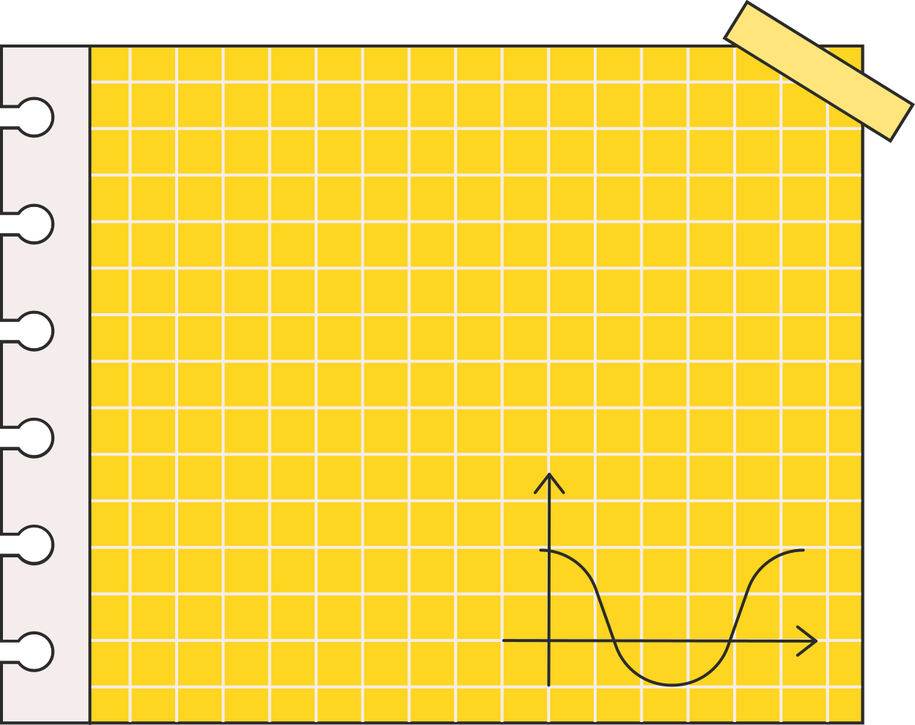
TEAM
CHANDRAKANTH YARLAGADDA (100944159)
MAYANK KHURANA (100883761)
PRIYANKA CHOUDHARY (100940752)
SAIRAJ UDAYSHANKAR (100865420)
SHARON KADAMANDLA (100929268)

Slide 3
TABLE OF CONTENTS
Definition & Overview
Functionalities & Stages
Schedule
Overall Architecture
Frontend Technology
Backend Technology
Database
AI Feature

Slide 4


•Create a comprehensive picture of the candidate
•Shortlist and rank candidates
•CV analysis using NLP
•Personality test
•Aptitude test
DEFINITION & OVERVIEW

Slide 5
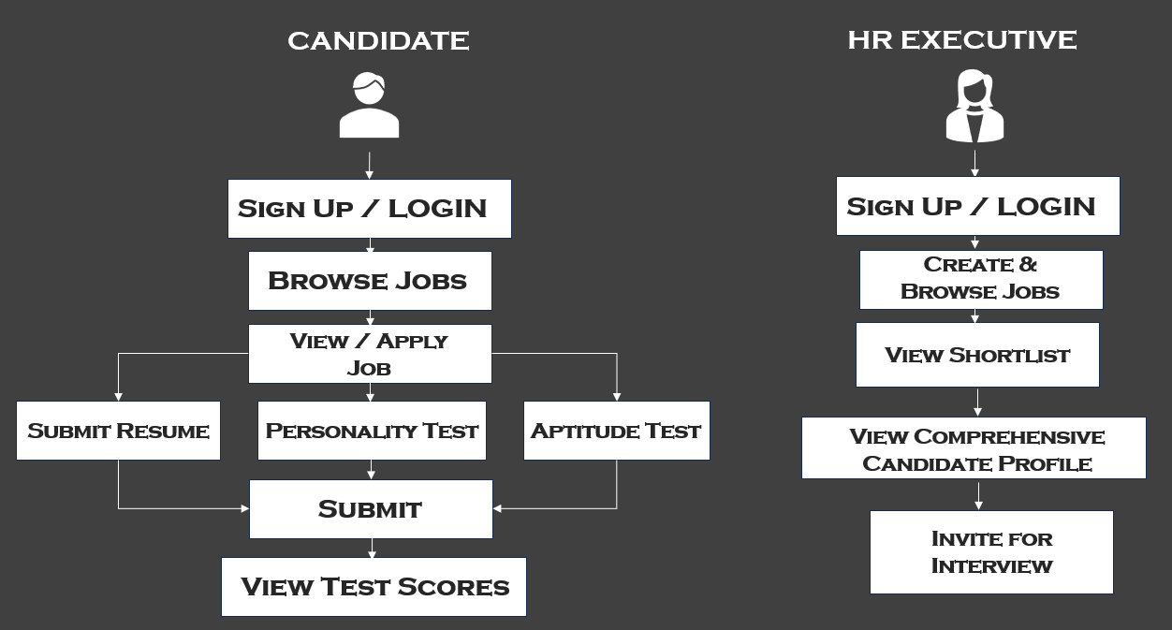
FUNCTIONALITIES & STAGES

Slide 6
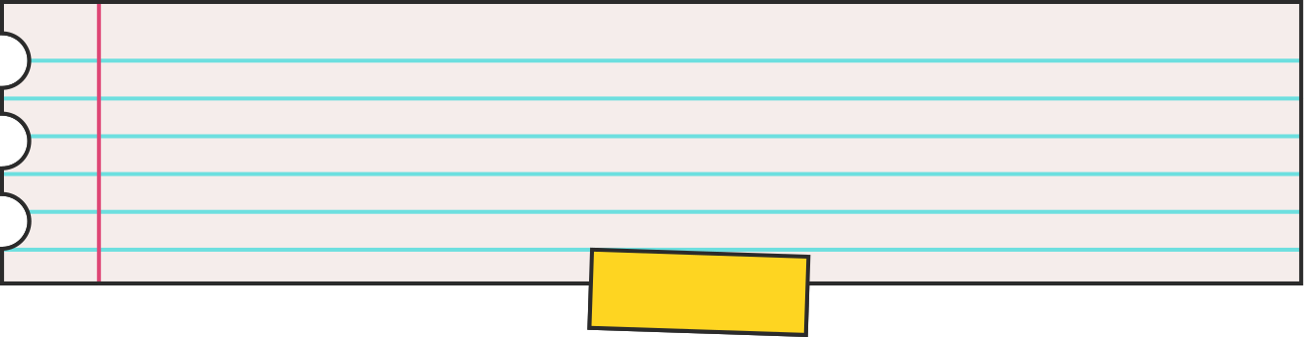
Stage | Functionality | Delivery Deadline
1 | Sign-up & Login | 2023-10-25
1 | Create Jobs - HR | 2023-10-25
1 | View Job Postings | 2023-10-25
2 | Upload Resume | 2023-11-07
2 | Personality Test | 2023-11-07
2 | Aptitude Test | 2023-11-07
3 | HR Rank List | 2023-12-06
3 | Personality Report / Scoresheet | 2023-12-06
3 | Schedule Interview Email | 2023-12-06
4 | Integration Testing | 2023-12-13
SCHEDULE

Slide 7

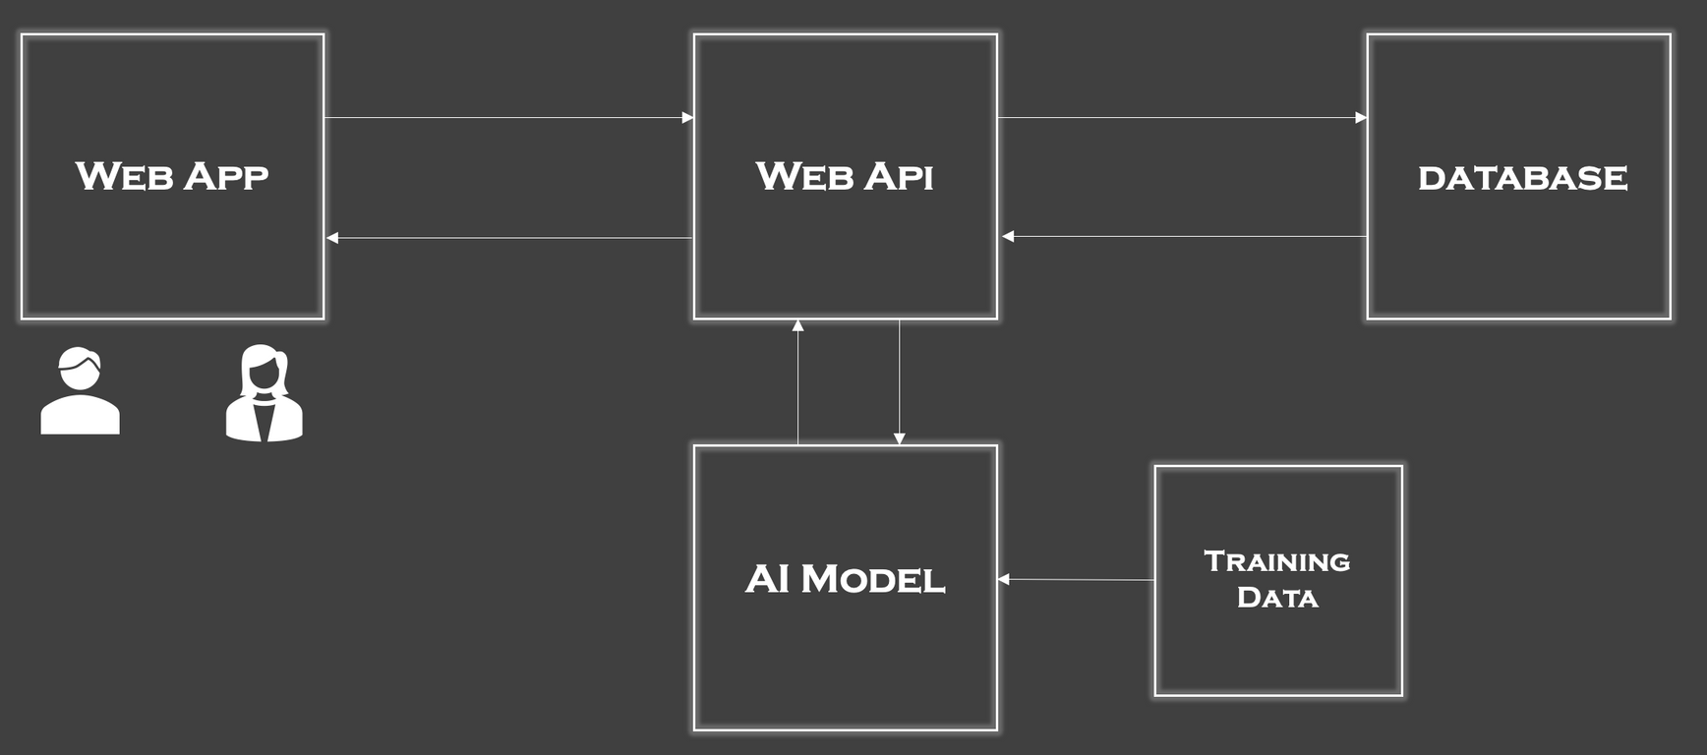

SYSTEM ARCHITECTURE

Slide 8

FRONTEND TECHNOLOGY
•Single Page Application Design
•Lightweight Client Rendering
•Extremely Modular
React JS

Slide 9


BACKEND TECHNOLOGY
NODE JS FOR THE API
TENSORFLOW FOR AI
•Convenience of JavaScript
•Ease of Server Setup
•Multitude of Available Libraries
•Convenience with Documents
•Built-in Pre-processing Tools
•Sequence Modeling Features

Slide 10



For Transactional Data
For ML Training
DATABASE TECHNOLOGY

Slide 11

AI FEATURE

Slide 12

THANK YOU

